Slide 1

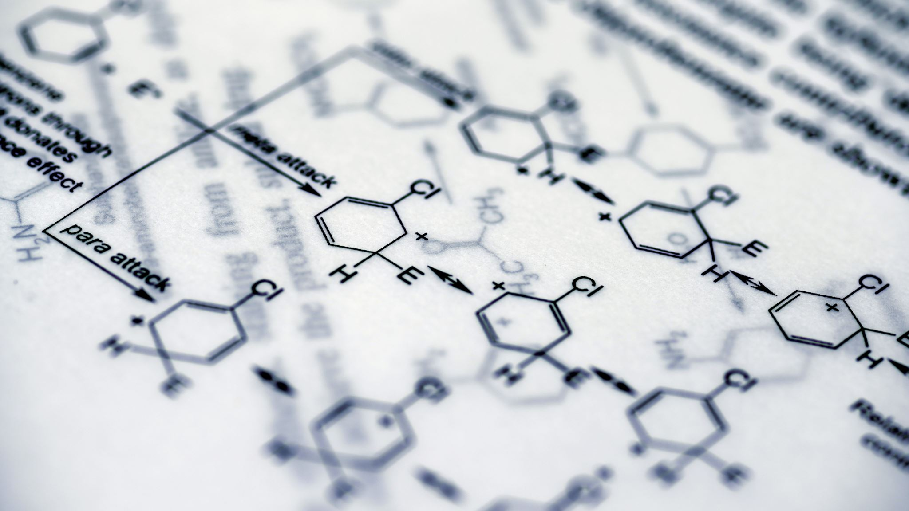
Dimensionality Reduction: Kernel PCA, t-SNE and UMAP
Khalid Al Nahyan 2101237
ML 813: Topics in Dimensionality Reduction and Manifold Learning
Date: February 19th 2025
Institution: Mohammed Bin Zayed University For Artificial Intelligence

Slide 2


Adgenda
Introduction
Literature Review
Description of Techniques
Examples and Comparison
Conclusion

Slide 3
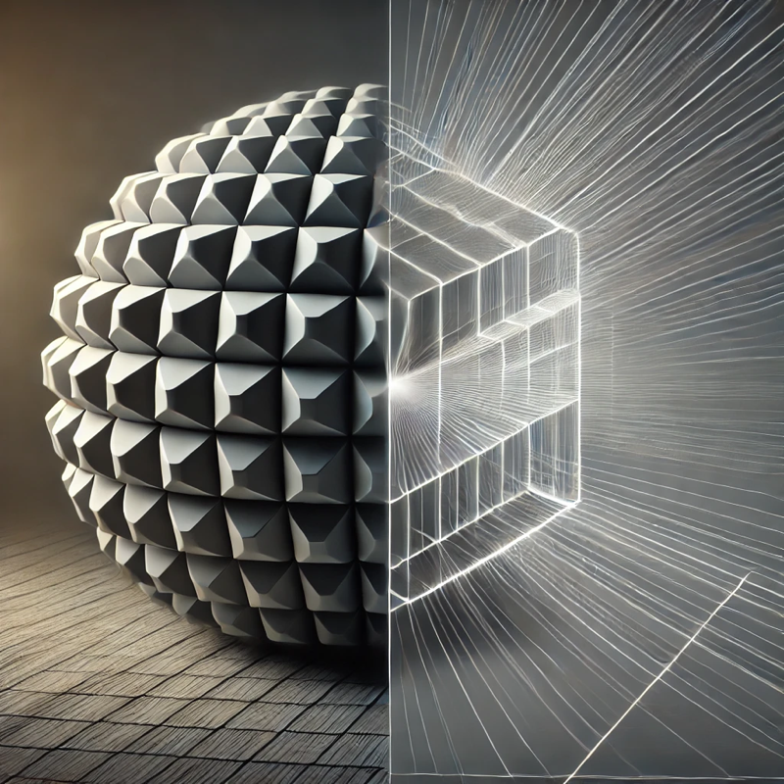
Introduction To Dimensionality Reduction
What Is Dimensionality Reduction?
Importance
Applications
Focus
Reducing Dataset’s Dimensionality
Keep Important Features
Simplification = Easier Analysis
Easy Computation
Effective Data Visualization
Image Processing
Genomics
Natural Language Processing
Customer Segmentation
Anomaly Detection
Kernel PCA, t-SNE and UMAP
Compare With PCA
Dimensionality Reduction: Mapping Complex Data To Simpler Representations
Notes:
So, to begin with, let’s define dimensionality reduction. As its name suggests, it’s an unsupervised learning technique that aims to reduce the number of dimensions in a dataset while preserving its essential features. For instance, consider the example of reducing a 3D ball to a 2D ball using dimensionality reduction. This process simplifies our datasets, making them easier to analyze and compute and enhancing visualization capabilities. Dimensionality reduction finds applications in various fields, including image processing, genomics, natural language processing, customer segmentation, and anomaly detection. Today, we’ll focus on three prominent dimensional reduction techniques: Kernel PCA, t-SNE, and UMAP. We’ll compare these techniques with the fundamental PCA algorithm.

Slide 4
Historical Impact On Dimensionality Reduction
1901
Principal Component Analysis (PCA)
A linear technique transforming data to a new system maximizing variance and principal components [1].
1936
Linear Discriminant Analysis (LDA)
A supervised method that finds linear combinations of features to separate classes [2].
1950s
Multidimensional Scaling (MDS)
Techniques that visualize the similarity of individual cases in a dataset [2].
1980s
Autoencoders (Resurgence In 2006)
Neural networks learn efficient coding by compressing input data gain prominence in 2006 from deep learning advancements [3].
1998
Kernel Principal Component Analysis
Extends PCA to nonlinear distributions using kernel methods [4].
2000
Isomap
MDS extension preserves geodesic distances, capturing manifold structure [2].
2008
t-Distributed Stochastic Embedding (t-SNE)
Focuses on preserving local similarities for high-dimensional data visualization [5].
2018
Uniform Manifold Approximation & Projection (UMAP)
Manifold learning preserves local and global data structures for clustering [6].
Notes:
This timeline traces the evolution of dimensionality reduction over the past century, showcasing how it has empowered different researchers to discern patterns, relationships, and valuable insights from increasingly intricate datasets. Each method builds upon its predecessors, continually adapting to emerging challenges and diverse applications.

Slide 5

Technique (Linearity/Machine Learning Type) | Strengths [8,9,10] | Limitations [8,9,10] | Key Applications [8,9,10]
PCA (Linear/Unsupervised) [7] | Effective for linearly separable data. | It may not capture the complexity of nonlinear relationships. | Data preprocessing, noise reduction
LDA (Linear/Supervised) [7] | Effective in supervised settings with class labels. | Relies on data distribution assumptions. | Feature extraction for classification
MDS (Nonlinear/Unsupervised) | Handles various data types. | Computationally intensive. | Psychological data analysis, marketing
AutoEncoders (Nonlinear/Unsupervised) | Neural network models excel at complex mappings. | They require data and tuning and overfitting risk. | Image denoising, anomaly detection
Kernel PCA (Nonlinear/Unsupervised) | Models nonlinear structures from Kernels. | Requires increased computational resources. | Pattern recognition, image denoising
Isomap (Nonlinear/Unsupervised) | Unfolds nonlinear manifolds. | Struggles with noise and computation. | Manifold learning, image processing
t-SNE (Nonlinear/Unsupervised) | Ideal for visualizing clusters in high-dimensional data locally | Can lead to misrepresentation of global structures | Data visualization
UMAP (Nonlinear/Unsupervised) | Balances between local and global structure preservation with efficient computation. | Results vary with parameter settings, theoretical foundations, and initializations. | Clustering, visualization in large datasets
Notes:
This table underscores the fact that no single technique is universally superior. Each method possesses its own strengths and weaknesses, and the selection process hinges on the specific requirements of the problem. Whether you prioritize linearity, visualization, clustering, or efficient computation, the appropriate technique will emerge from the analysis.

Slide 6
Key Insights and Applications
Evolution from Linear to Nonlinear Methods
Early methods focus on linear transformations.
Nonlinear methods evolved to undercover complex and high dimensional data structures.
Various Fields
Autoencoders and Isomap have enhanced feature extraction and image reconstruction in image processing.
In natural language processing, techniques like t-SNE and UMAP have improved the visualization of word embeddings.
PCA and Kernel PCA have been instrumental in analyzing gene expression data in genomics.
Notes:
The key insights reveal that during the evolution of Dimensionality Reduction techniques, they initially focused on linear transformations, such as PCA. However, as time progressed, the emphasis shifted towards non-linear transformations, particularly in handling large-dimensional and complex data structures. Deep learning techniques also became increasingly integrated into Dimensionality Reduction. As illustrated in the previous slide’s table, Dimensionality Reduction finds applications in various fields: - Autoencoders and Isomap have advanced feature extraction and image reconstruction techniques, significantly enhancing image processing capabilities. - In natural language processing (NLP), methods like t-SNE and UMAP have improved the visualization of word embeddings, making high-dimensional text representations more interpretable. - PCA and Kernel PCA have played a pivotal role in genomics, enabling the analysis of gene expression data and uncovering patterns in biological research.

Slide 7
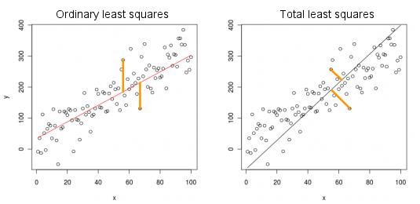
Principal Component Analysis (1/3)
A Linear method is used by projecting data into a new axis called principal components to maximize variance
Instead of projecting vertically like linear regression, PCA projects orthogonally
Notes:
Firstly, we’ll examine the most fundamental method, Principal Component Analysis (PCA). PCA is a linear technique that involves projecting data onto a new axis called the Principal Components, which gives it its name. The primary objective of PCA is to maximize the variance, as evident in the comparison of images from above representing basic linear regression on the left and PCA on the right. Unlike linear regression, which projects vertically, PCA projects orthogonally.

Slide 8
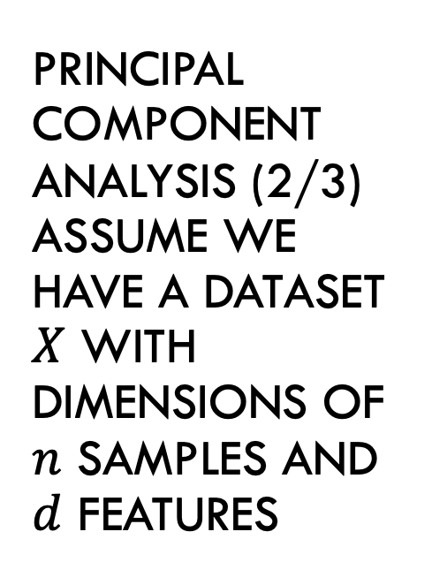
Principal Component Analysis (2/3) Assume we have a dataset $X$ with dimensions of $n$ samples and $d$ features
Centralize the dataset by taking the mean as ${\overline{X}}_{i}$ of each feature to centralize it by subtracting them from each sample, we’ll call this ${\hat{X}}_{i,n}=X_{i,n}−{\overline{X}}_{i}$.
Centralize the dataset by taking the mean as 𝑋 ̅_𝑖 of each feature to centralize it by subtracting them from each sample, we’ll call this 𝑋 ̂_(𝑖,𝑛)=𝑋_(𝑖,𝑛)−𝑋 ̅_𝑖.
Find the covariance matrix by this: $C=\frac{1}{n−1}{\hat{X}}^{T}\hat{X}$
Find the covariance matrix by this: 𝐶=1/(𝑛−1) 𝑋 ̂^𝑇 𝑋 ̂
Find the eigenvalues of the covariance matrix ($\det\left(C−λI\right)=0$) and depending what size to reduce it to take the top $p$ largest eigenvalues (call it $λ^{′}$)
Find the eigenvalues of the covariance matrix (det⁡(𝐶−𝜆𝐼)=0) and depending what size to reduce it to take the top 𝑝 largest eigenvalues (call it 𝜆^′)
Find the eigenvector $U$ by using the largest found eigenvalues $λ^{′}$
Find the eigenvector 𝑈 by using the largest found eigenvalues 𝜆^′
Normalize the eigenvectors by this: $e=\frac{U}{\left\|U\right\|}$
Normalize the eigenvectors by this: 𝑒=𝑈/‖𝑈‖
Find the reduced PCA to $p$ features results by this: $PCA=e^{T}{\hat{X}}^{T}$
Find the reduced PCA to 𝑝 features results by this: 𝑃𝐶𝐴=𝑒^𝑇 𝑋 ̂^𝑇

Slide 9
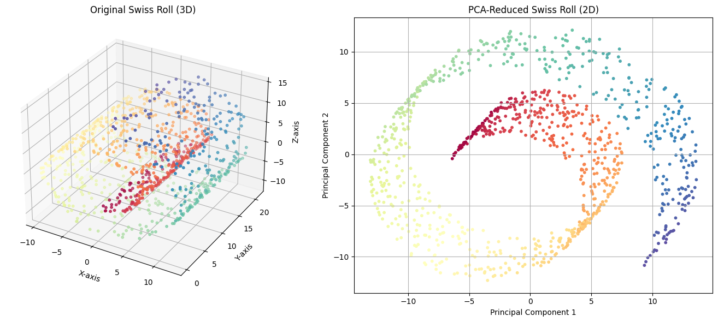
Principal Component Analysis (3/3)
Captures much of the variance but struggles to preserve the nonlinearity

Slide 10

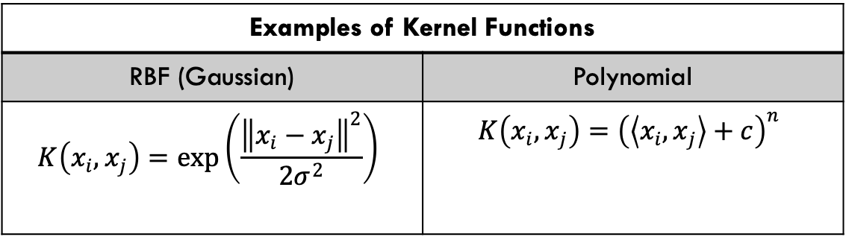
Kernel Principal Component Analysis (1/3)
Extension of the Principal Component Analysis using kernel functions to capture non-linear patterns
Examples of Kernel Functions
RBF (Gaussian) | Polynomial
$$K\left(x_{i},x_{j}\right)=exp\left(\frac{{\left\|x_{i}−x_{j}\right\|}^{2}}{2σ^{2}}\right)$$ | $$K\left(x_{i},x_{j}\right)={\left(\left\langle x_{i},x_{j}\right\rangle +c\right)}^{n}$$
Notes:
Building upon the foundation of Principal Component Analysis (PCA), we introduce its nonlinear extension, Kernel Principal Component Analysis (Kernel PCA). Unlike standard PCA, which is confined to linear projections, Kernel PCA utilizes Kernel Functions to transform data into a higher-dimensional space, enabling it to reveal intricate, nonlinear patterns. The fundamental concept behind Kernel PCA lies in employing functions such as the Radial Basis Function (RBF) kernel and Polynomial kernel. These kernels transform the original data space into a more intricate feature space. The RBF kernel calculates similarity using an exponential function, while the polynomial kernel introduces nonlinearity by raising the dot product of inputs to a power. By harnessing these kernels, Kernel PCA captures complex structures that traditional PCA would overlook, making it particularly effective for tasks involving curved or nonlinear data distributions.

Slide 11
Kernel Principal Component Analysis (2/3)
Calculate the kernel matrix $K\left(x_{i},x_{j}\right)=φ(x_{i})φ(x_{j})$ for every data point pairs
Calculate the kernel matrix 𝐾(𝑥_𝑖,𝑥_𝑗 )=𝜙(𝑥_𝑖)𝜙(𝑥_𝑗) for every data point pairs
Center $K$ to create zero mean: $\hat{K}=K−1_{n}K−K1_{n}+1_{n}K1_{n}$, $1_{n}$ is an $n × n$ matrix with every entry as $\frac{1}{n}$
Center 𝐾 to create zero mean: 𝐾 ̂=𝐾−1_𝑛 𝐾−𝐾1_𝑛+1_𝑛 𝐾1_𝑛, 1_𝑛 is an 𝑛 × 𝑛 matrix with every entry as 1/𝑛
Find the eigenvalues of the centralized kernel matrix ($\det\left(\hat{K}−λI\right)=0$)and depending what size to reduce it to take the top $p$ largest eigenvalues (call it $λ^{′}$)
Find the eigenvalues of the centralized kernel matrix (det⁡(𝐾 ̂−𝜆𝐼)=0)and depending what size to reduce it to take the top 𝑝 largest eigenvalues (call it 𝜆^′)
Find the eigenvector $U$ by using the largest found eigenvalues $λ^{′}$
Find the eigenvector 𝑈 by using the largest found eigenvalues 𝜆^′
Normalize the eigenvectors by this: $e=\frac{U}{\left\|U\right\|}$
Normalize the eigenvectors by this: 𝑒=𝑈/‖𝑈‖
Find the reduced Kernel PCA to $p$ features results by this: $PCA=e^{T}{\hat{K}}^{T}$
Find the reduced Kernel PCA to 𝑝 features results by this: 𝑃𝐶𝐴=𝑒^𝑇 𝐾 ̂^𝑇
The only difference is we are focusing on the Kernel Matrix and not the Covariance Matrix

Slide 12
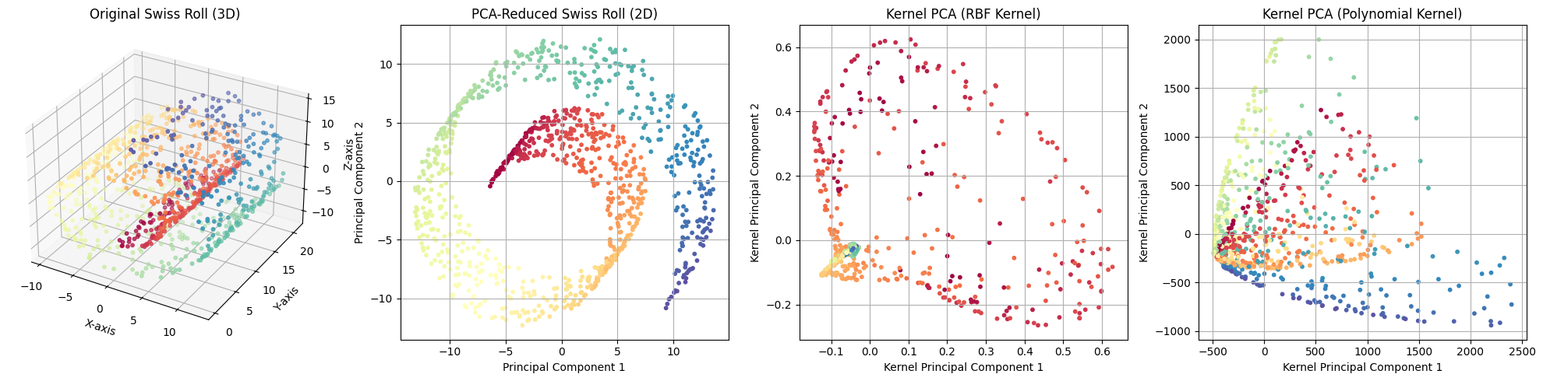
Kernel Principal Component Analysis (3/3)
PCA flattens this dataset linearly, while Kernel PCA with RBF unrolls it nonlinearly. Polynomial kernel shows limited success with distortions due to sensitivity in dimensions.
Notes:
Polynomial at 3 degrees with a coefficient of 1

Slide 13
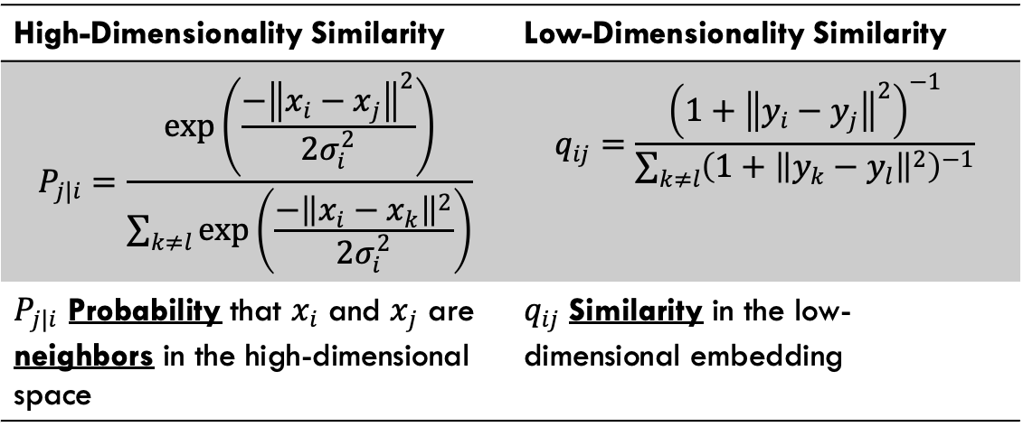
t-Distributed Stochastic Embedding (t-SNE) (1/3)
A probabilistic dimensionality reduction technique is designed to preserve local relationships between data points in a high-dimensional space for image recognition or genomics visualization.
High-Dimensionality Similarity | Low-Dimensionality Similarity
$$P_{j|i}=\frac{exp\left(\frac{−{\left\|x_{i}−x_{j}\right\|}^{2}}{2σ_{i}^{2}}\right)}{\sum_{k≠l}{\exp\left(\frac{−{\left\|x_{i}−x_{k}\right\|}^{2}}{2σ_{i}^{2}}\right)}}$$ | $$q_{ij}=\frac{{\left(1+{\left\|y_{i}−y_{j}\right\|}^{2}\right)}^{−1}}{\sum_{k≠l}{{\left(1+{\left\|y_{k}−y_{l}\right\|}^{2}\right)}^{−1}}}$$
$P_{j|i}$ Probability that $x_{i}$ and $x_{j}$ are neighbors in the high-dimensional space | $q_{ij}$ Similarity in the low-dimensional embedding
Notes:
Moving beyond linear techniques like PCA and Kernel PCA, we introduce t-Distributed Stochastic Neighbor Embedding (t-SNE), a probabilistic dimensionality reduction method. Unlike PCA, which aims to maximize variance, t-SNE is specifically designed to preserve local relationships between data points. This makes it particularly effective for high-dimensional data visualization, such as in image recognition or genomics. t-SNE works by calculating pairwise similarities between points in high- and low-dimensional spaces. In the original high-dimensional space, it models similarity using Gaussian distributions. However, the lower-dimensional embedding replaces this with t-distributions to prevent crowding effects. This ensures that neighboring points remain close, effectively revealing clusters and underlying patterns in the data. By preserving local structure, t-SNE provides an intuitive and visually interpretable representation of complex datasets. This makes it a powerful tool for exploratory data analysis.

Slide 14
t-Distributed Stochastic Embedding (t-SNE) (2/3)
Calculate $P_{j|i}$for all pairs of points in high-dimensional space then symmetrize by this equation: $P_{ij}=\frac{P_{j|i}+P_{i|j}}{2n}$.
Calculate 𝑷_(𝒋|𝒊) for all pairs of points in high-dimensional space then symmetrize by this equation: 𝑷_𝒊𝒋=(𝑷_(𝒋|𝒊)+𝑷_(𝒊|𝒋))/𝟐𝒏.
Initialize random low-dimensional points $y_{i}$
Initialize random low-dimensional points 𝒚_𝒊
Minimize the Kullback-Leibler (KL) Divergence between $P_{ij}$ and $q_{ij}$ by this equation: $KL(P|\left|Q\right)=\sum_{i≠j}{P_{ij}\log\left(\frac{P_{ij}}{q_{ij}}\right)}$
Minimize the Kullback-Leibler (KL) Divergence between 𝑷_𝒊𝒋 and 𝒒_𝒊𝒋 by this equation: 𝑲𝑳(𝑷||𝑸)=∑_(𝒊≠𝒋)▒〖𝑷_𝒊𝒋 𝒍𝒐𝒈⁡(𝑷_𝒊𝒋/𝒒_𝒊𝒋 ) 〗
Update $y_{i}$ iteratively to reduce the KL divergence with learning rate $η$: $y_{i}^{(t+1)}=y_{i}^{(t)}−η\frac{∂KL}{∂y_{i}}$
Update 𝒚_𝒊 iteratively to reduce the KL divergence with learning rate 𝜼: 𝒚_𝒊^((𝒕+𝟏))=𝒚_𝒊^((𝒕))−𝜼 𝝏𝑲𝑳/(𝝏𝒚_𝒊 )

Slide 15
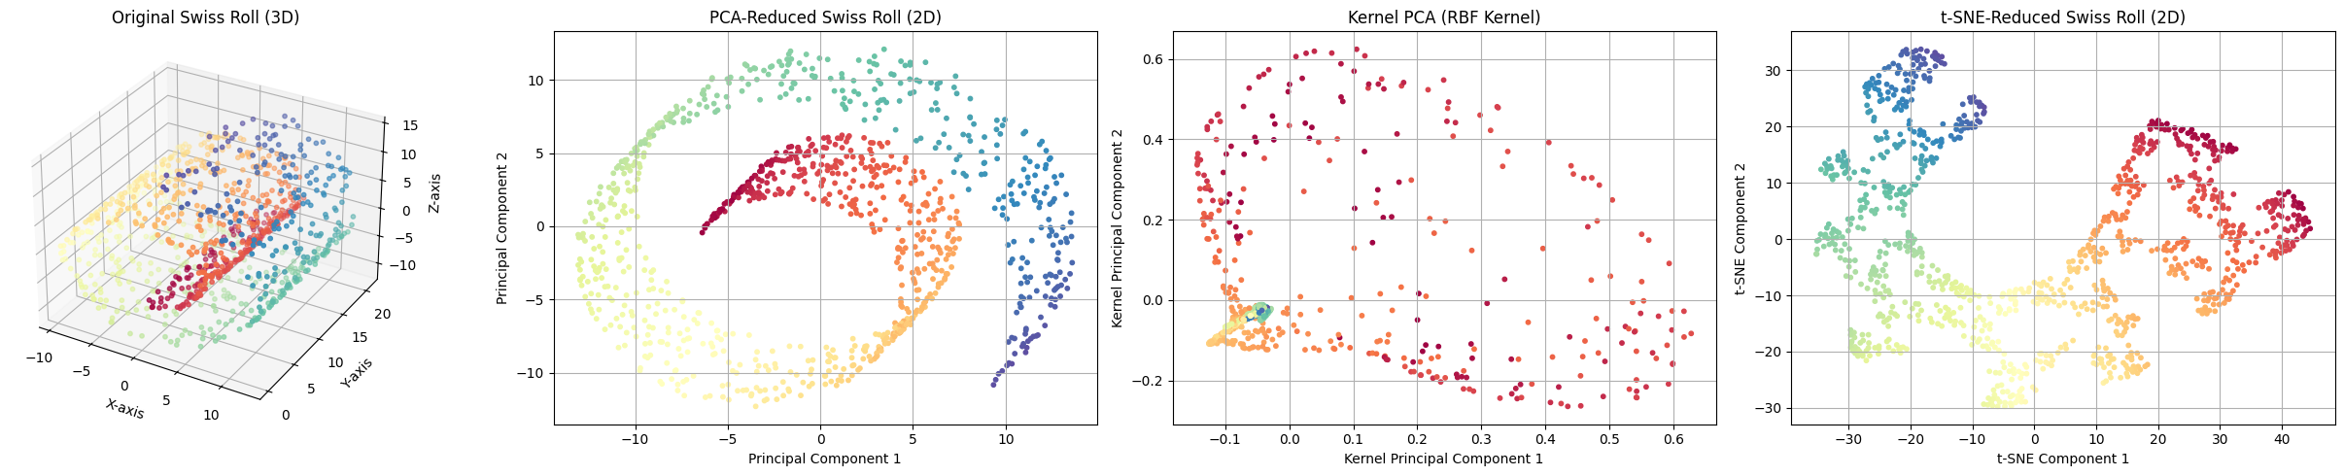
t-Distributed Stochastic Embedding (t-SNE) (3/3)
The t-SNE helps visualize the reduced dataets localy but it doesn’t retain the global strucutre similar to PCA and Kernel PCA
Notes:
Polynomial at 3 degrees with a coefficient of 1

Slide 16
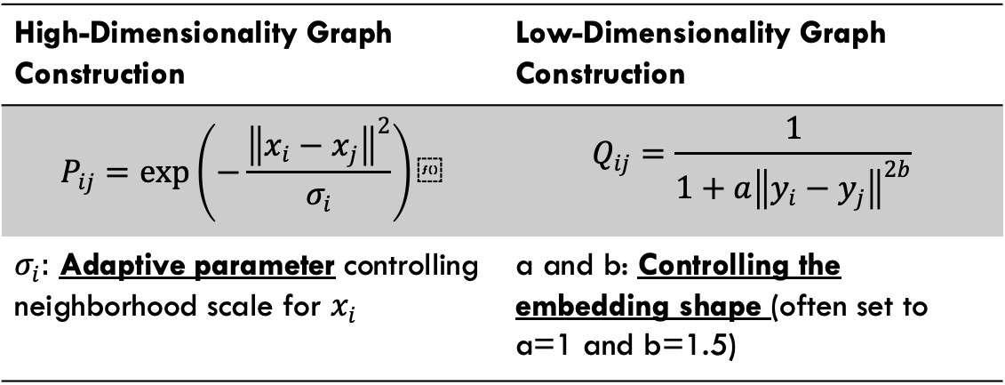
Uniform Manifold Approximation & Projection (1/3)
A nonlinear dimensionality reduction technique preserving the high dimensional data’s structure both locally and globally.
Used for both visualization and downstream machine - learning tasks
High-Dimensionality Graph Construction | Low-Dimensionality Graph Construction
$$P_{ij}=exp\left(−\frac{{\left\|x_{i}−x_{j}\right\|}^{2}}{σ_{i}}\right)⁡$$ | $$Q_{ij}=\frac{1}{1+a{\left\|y_{i}−y_{j}\right\|}^{2b}}$$
$σ_{i}:$ Adaptive parameter controlling neighborhood scale for $x_{i}$ | a and b: Controlling the embedding shape (often set to a=1 and b=1.5)
Notes:
Uniform Manifold Approximation and Projection (UMAP) is a dimensionality reduction technique aiming to preserve local and global structures in high-dimensional data. Unlike t-SNE, which primarily focuses on local neighborhoods, UMAP balances local and global relationships, making it highly effective for visualization and downstream machine-learning tasks. Using an adaptive neighborhood scale, UMAP constructs a high-dimensional graph by modeling the probability of connections between points. This flexibility allows it to capture different data densities effectively. In the lower-dimensional space, embedding is optimized by controlling the shape of the representation through hyperparameters a and b. These parameters are often set to values like a = 1 and b = 1.5 to ensure structure preservation. By leveraging these principles, UMAP generates compact and interpretable embeddings, making it a preferred choice for tasks requiring both efficiency and scalability in dimensionality reduction.

Slide 17
Uniform Manifold Approximation & Projection (2/3)
Construct a High-Dimensional Graph using the nearest neighbor method and calculate $P_{ij}$
Construct a High-Dimensional Graph using the nearest neighbor method and calculate 𝑷_𝒊𝒋
Create A low-dimensional graph with random variables $y_{i}$ and $y_{j}$ then calculate $Q_{ij}$
Create A low-dimensional graph with random variables 𝒚_𝒊 and 𝒚_𝒋 then calculate 𝑸_𝒊𝒋
Optimize with cross-entropy loss: $L=−\sum_{i,j}{\left[P_{ij}\log\left(Q_{ij}\right)+\left(1−P_{ij}\right)\log\left(1−Q_{ij}\right)\right]}$
Optimize with cross-entropy loss: 𝑳=−∑_(𝒊,𝒋)▒[𝑷_𝒊𝒋 𝐥𝐨𝐠⁡〖(𝑸_𝒊𝒋 )+〗 (𝟏−𝑷_𝒊𝒋 ) 𝒍𝒐𝒈⁡(𝟏−𝑸_𝒊𝒋 ) ]
Adjust the low-dimensional embedding iteratively to preserve the structure locally and globally: $y_{i}^{(t+1)}=y_{i}^{(t)}−η\frac{∂L}{∂y_{i}}$
Adjust the low-dimensional embedding iteratively to preserve the structure locally and globally: 𝒚_𝒊^((𝒕+𝟏))=𝒚_𝒊^((𝒕))−𝜼 𝝏𝑳/(𝝏𝒚_𝒊 )

Slide 18
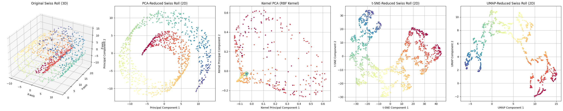
Uniform Manifold Approximation & Projection (3/3)
UMAP combines the t-SNE and Kernel PCA strengths, making it a good choice for local and global dimensionality reduction.
Notes:
Polynomial at 3 degrees with a coefficient of 1

Slide 19
Experiment
Use
Use five different datasets
Moons
Iris
Wine
Digits
Breast Cancer
Cluster
Cluster using Gaussian Mixture Method with n unique labels components
Look
Look at the structure and geometry of the clusters by the Silhouette Score
Evaluate
Evaluate clustering accuracy using ground truth labels with the Adjusted Rand Index (ARI) (More robust to randomness)
Compare
Compare Scores
Notes:
"Moons": make_moons(n_samples=500, noise=0.05, random_state=42),
"Iris": load_iris(return_X_y=True),
"Wine": load_wine(return_X_y=True),
"Digits": load_digits(return_X_y=True),
"Breast Cancer": load_breast_cancer(return_X_y=True)
Silhouette": silhouette_score(X_reduced, gmm_labels),
"ARI": adjusted_rand_score(labels_true, gmm_labels),
"NMI": normalized_mutual_info_score(labels_true, gmm_labels) “Moons”: make_moons(n_samples=500, noise=0.05, random_state=42), “Iris”: load_iris(return_X_y=True), “Wine”: load_wine(return_X_y=True), “Digits”: load_digits(return_X_y=True), “Breast Cancer”: load_breast_cancer(return_X_y=True) “Silhouette”: silhouette_score(X_reduced, gmm_labels), “ARI”: adjusted_rand_score(labels_true, gmm_labels), “NMI”: normalized_mutual_info_score(labels_true, gmm_labels) I’ve conducted an experiment to assess the effectiveness of clustering techniques after applying four-dimensional reduction methods from the presentation. I’ll use five diverse datasets to reduce them to two dimensions using these techniques. Subsequently, I’ll apply the Gaussian mixture method with n unique labels for each dataset. After the experiment, I’ll evaluate the clusters’ structure and geometry using the silhouette score and assess accuracy using the adjusted rand index, comparing these scores.

Slide 20
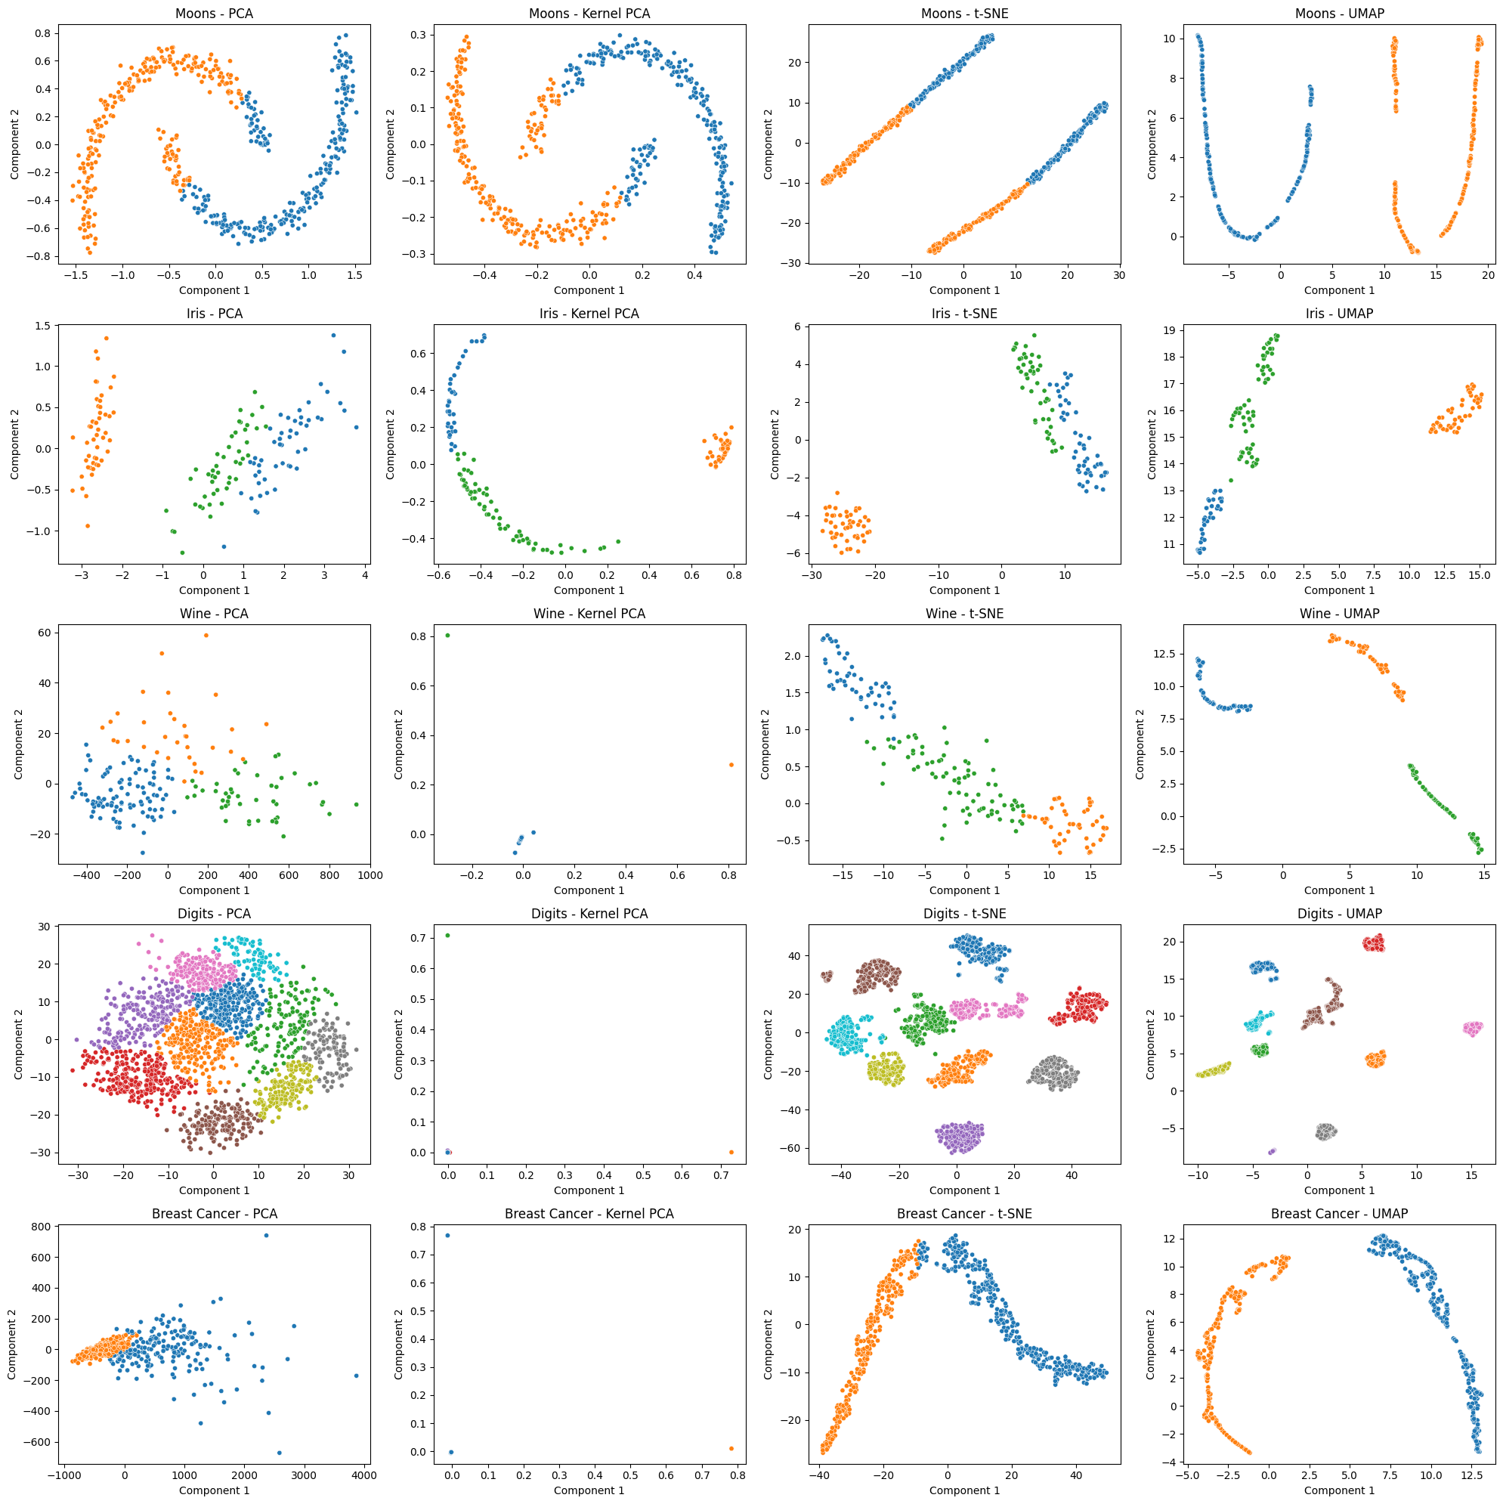
Notes:
These figures demonstrate the reduced datasets with their clusters. While PCA can linearly reduce the dataset, more modern techniques like t-SNE and UMAP offer significantly improved clustering capabilities. These techniques focus on non-linearity and simplify the process of categorizing labels.

Slide 22
Silhouette Results (1/2)
 | PCA | k-PCA | t-SNE | UMAP
Moons | 0.473966 | 0.492653 | 0.385667 | 0.640706
Iris | 0.531308 | 0.689632 | 0.643288 | 0.723877
Wine | 0.335238 | 0.994854 | 0.542331 | 0.750638
Digits | 0.383747 | 0.997250 | 0.642731 | 0.785430
Breast Cancer | 0.586582 | 0.993999 | 0.545795 | 0.584758
Notes:
Kernel PCA excels in capturing cluster structures in non-linear data, as evident in its success with the Wine, Digits, and Breast Cancer datasets. On the other hand, UMAP is highly effective in low-dimensional clustering tasks, particularly for the Moons and Iris datasets. However, t-SNE struggles in various datasets, suggesting that it may not preserve compact cluster separation as effectively as other methods. While PCA performs consistently, it is generally outperformed by Kernel PCA and UMAP.

Slide 23
ARI Results (2/2)
 | PCA | k-PCA | t-SNE | UMAP
Moons | 0.466787 | 0.445112 | -0.001430 | 1.000000
Iris | 0.941045 | 0.745504 | 0.903768 | 0.745504
Wine | 0.370488 | 0.001289 | 0.400969 | 0.400727
Digits | 0.371540 | 0.000002 | 0.897923 | 0.22497
Breast Cancer | 0.748459 | -0.002828 | 0.324307 | 0.405858
Notes:
UMAP excels in specific datasets with non-linear separability, such as the Moon dataset. In contrast, PCA consistently performs well across various datasets, especially those with linear separability, like the Breast Cancer and Iris datasets. t-SNE is particularly strong for complex and high-dimensional datasets, such as the Digits dataset, but it may not be as consistent overall. On the other hand, Kernel PCA struggles with preserving clustering, which may be due to its parameter sensitivity.

Slide 24
Conclusion
Dimension Reduction:
PCA: Best for linear structures but lacks nonlinearity handling.
Kernel PCA: Captures nonlinearity using kernels but requires careful tuning.
t-SNE: Preserves local structures for clustering but loses global relationships.
UMAP: Balances local and global structures, ideal for visualization & ML tasks (UMAP=k-PCA+T-SNE).
The best technique
Future research
Comparison of Techniques
Reduces data complexity, improves performance, and aids visualization.
Depends on the data and the application.
Should enhance efficiency & scalability.
Notes:
In conclusion, dimension reduction is an unsupervised technique that simplifies datasets, enhances performance, and facilitates visualization. We compared four techniques: PCA, Kernel PCA, t-SNE, and UMAP. PCA is suitable for linear datasets due to its inability to handle nonlinearity as effectively as Kernel PCA. Kernel PCA employs kernels to address nonlinearity issues, but careful tuning is necessary depending on the type of kernel used. t-SNE performs well for visualization but is limited to local analysis. UMAP combines the strengths of Kernel PCA and t-SNE to handle the global structure of the dataset, as evidenced by the experimental scores. Ultimately, the choice of dataset and application determines the most suitable technique and future research should focus on enhancing efficiency and scalability to address the growing interest in neural networks.

Slide 25
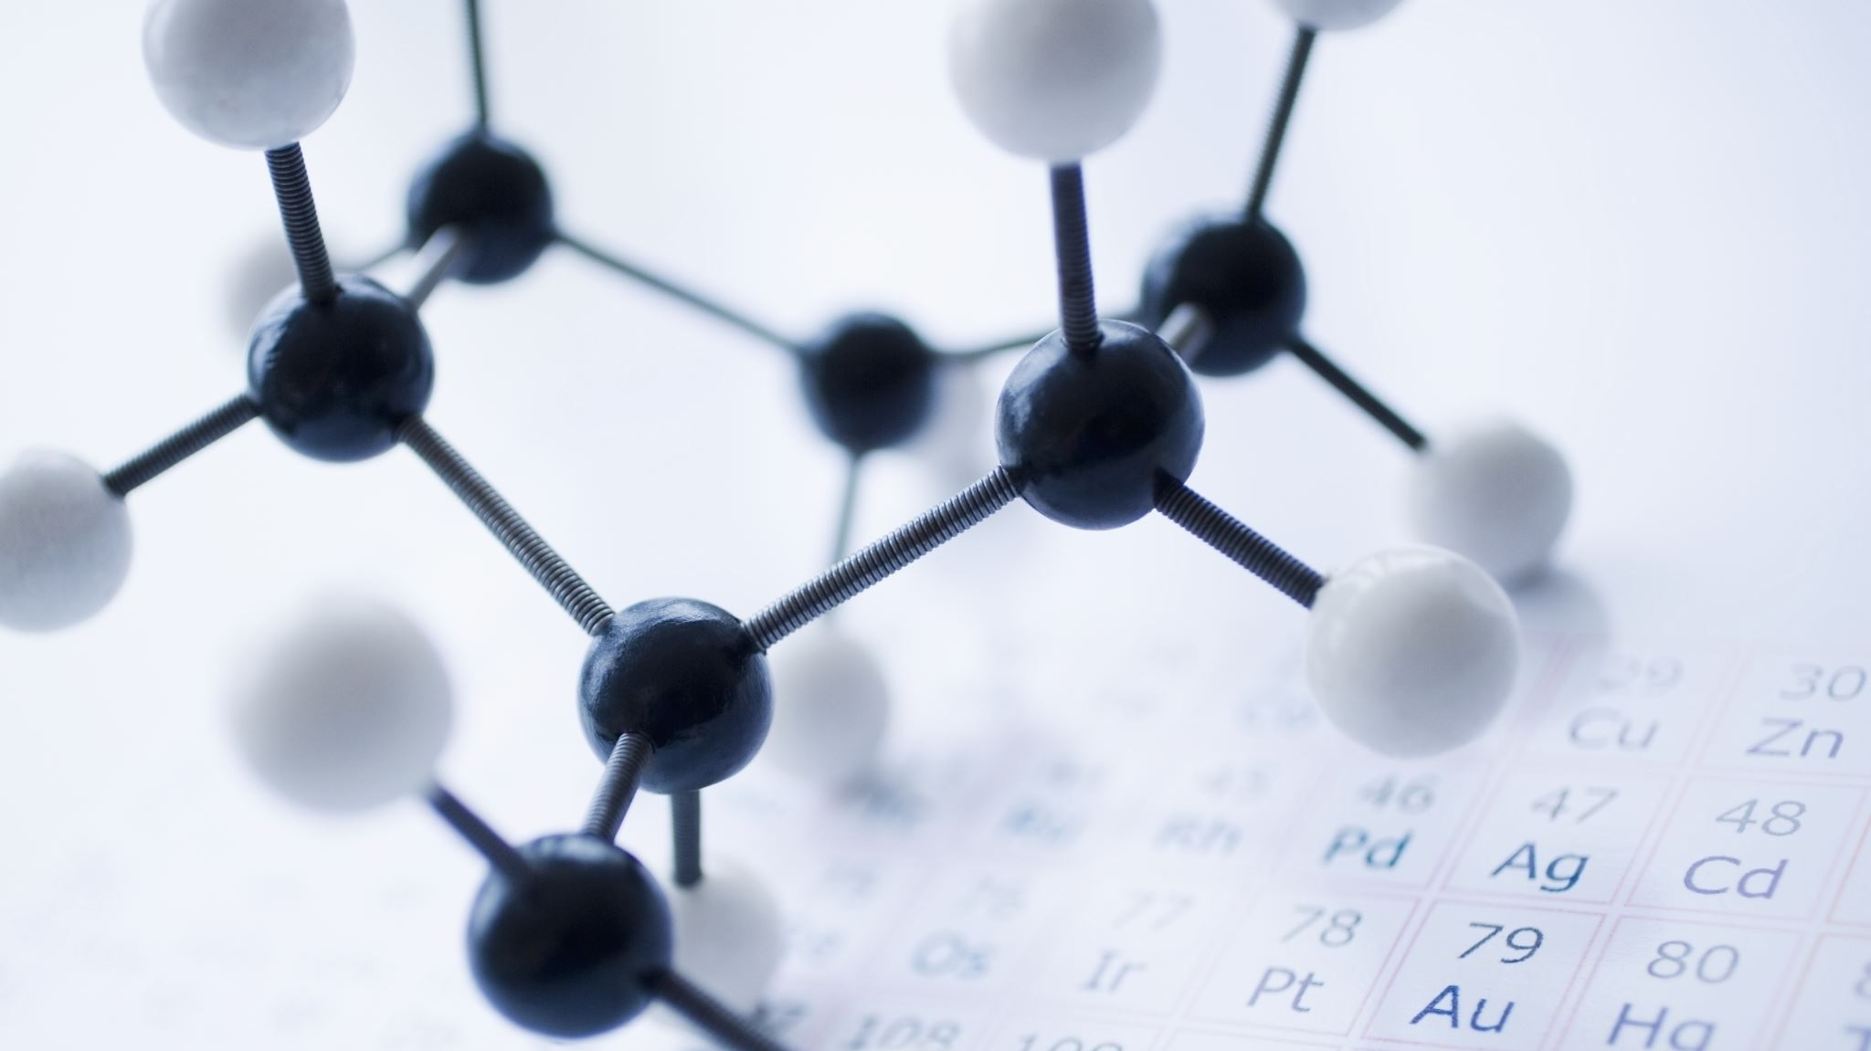
References
Sun, Y., Helmholz, H., & Willumeit-Römer, R. (2024). Systemic modulation of skeletal mineralization by magnesium implant promoting fracture healing: Radiological exploration enhanced with PCA-based machine learning in a rat femoral model. Journal of Magnesium and Alloys, 12(3), 1009-1020.
https://encord.com/blog/dimentionality-reduction-techniques-machine-learning/
https://medium.com/@conniezhou678/unveiling-dimensionality-reduction-a-comparative-analysis-of-9-methods-part-10-8594f8cd4336
Tonin, F., Tao, Q., Patrinos, P., & Suykens, J. A. (2024). Deep Kernel Principal Component Analysis for multi-level feature learning. Neural Networks, 170, 578-595.
Vikas, B., Makkapati, S. S., Bogireddy, S. R., Balamurugan, K. S., & Deepa, M. (2024, October). Advancements in lung cancer diagnosis: A comprehensive study on the role of PCA, LDA, and t-SNE in deep learning frameworks. In 2024 Asian Conference on Communication and Networks (ASIANComNet) (pp. 1-7). IEEE.
Taghizadeh-Mehrjardi, R., Nabiollahi, K., Kebonye, N. M., Kakhani, N., Ghebleh-Goydaragh, M., Heung, B., ... & Scholten, T. (2024). High-performance soil class delineation via UMAP coupled with machine learning in Kurdistan Province, Iran. Geoderma Regional, 36, e00754.
Nanga, S., Bawah, A. T., Acquaye, B. A., Billa, M.-I., Baeta, F. D., Odai, N. A., Obeng, S. K., & Nsiah, A. D. (2021). Review of dimension reduction methods. Journal of Data Analysis and Information Processing, 9(3), 189–231. https://doi.org/10.4236/jdaip.2021.93013
Ahmad, N., & Nassif, A. B. (2022). Dimensionality reduction: Challenges and solutions. In ITM Web of Conferences (Vol. 43, p. 01017). EDP Sciences.
Van Der Maaten, L., Postma, E. O., & Van Den Herik, H. J. (2009). Dimensionality reduction: A comparative review. Journal of machine learning research, 10(66-71), 13.
Palo, H. K., Sahoo, S., & Subudhi, A. K. (2021). Dimensionality reduction techniques: Principles, benefits, and limitations. Data Analytics in Bioinformatics: A Machine Learning Perspective, 77-107.

Slide 26

Image Sources
3D to 2D ball Slide 3 (AI Generated): https://chatgpt.com/share/6799b692-73cc-8011-80d4-ac772497cb55
Linear Regression vs PCA Slide 7: https://stats.stackexchange.com/questions/13152/how-to-perform-orthogonal-regression-total-least-squares-via-pca

